Slide 1

SHRI GOVINDRAM SEKSARIA INSTITUTE OF TECHNOLOGY AND SCIENCE INDORE
Department of Information Technology
M.Tech Second Year Semester IV Session : Jan2025 – July2025
Human Anomaly Detection in Thermal Image using Deep Learning
GUIDED BY:
Prof. Sonu Airen
CO-GUIDED BY:
Prof. C.P. Singar
PRESENTED BY:
Dhananjay Kumar Prasad
0801IT23MT03

Slide 2
Contents
Introduction
Project Description
Problem Statement
Literature Review
Datasets
Methodology
Results
Conclusion
Reference

Slide 3
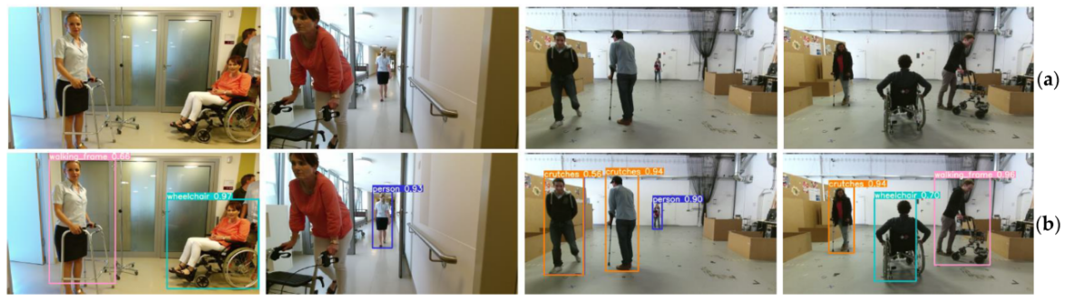
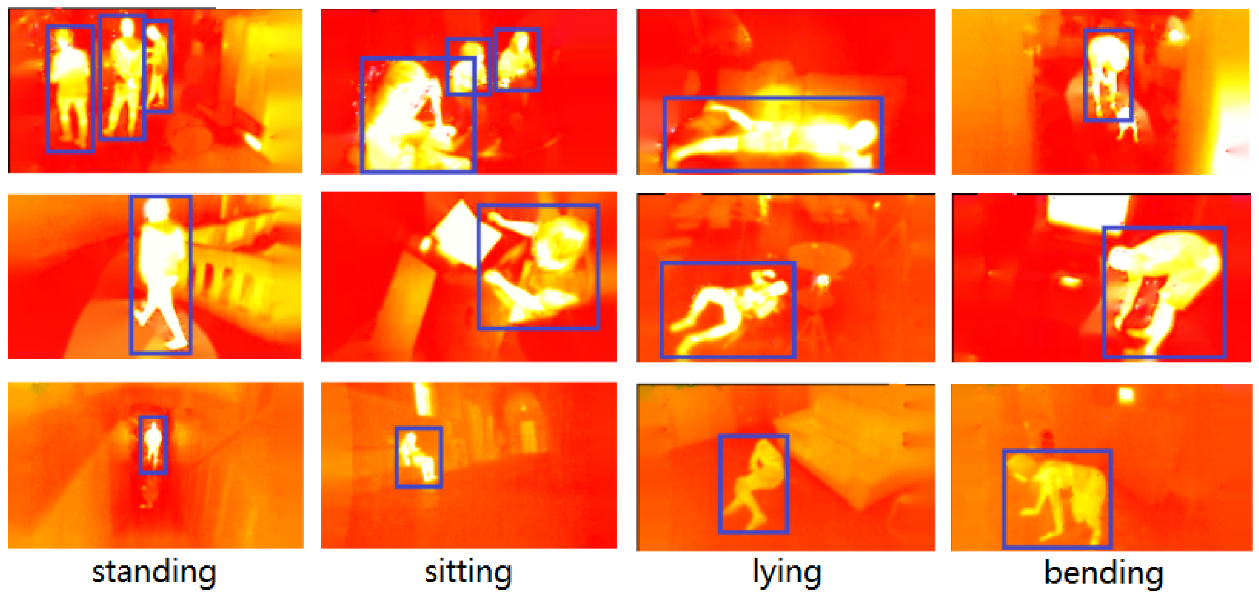
Introduction
Thermal imaging captures heat signatures instead of visible light, enabling vision in dark or low-visibility environments.
This project uses thermal frames to identify human actions and anomalies through pose-based analysis.
The goal is to build a robust, privacy-preserving system for real-time monitoring in surveillance, healthcare, and safety applications.
Visible Image: Captures reflected light in the 0.4–0.7 µm range, showing color and texture, but depends on lighting and struggles in darkness.
Thermal Image: Captures infrared radiation (8–15 µm) emitted by objects, showing heat patterns and working well in low-light or obscured environments.
Fig.1 Visible image
Fig.2 Thermal Image

Slide 4
Project Description
The project focuses on human action recognition and anomaly detection using thermal frames, reliable even in low-light or obstructed environments.
A YOLOv8-Pose model is used to detect humans and estimate 17 keypoints per person, capturing posture and motion effectively.
A custom thermal frame dataset was created with bounding boxes, keypoints, and nine action classes such as Walking, Sitting, Push-ups, Lying, and Abnormal.
The system classifies normal and abnormal actions in real time, supporting applications in surveillance, healthcare, defense, and industrial safety.

Slide 5
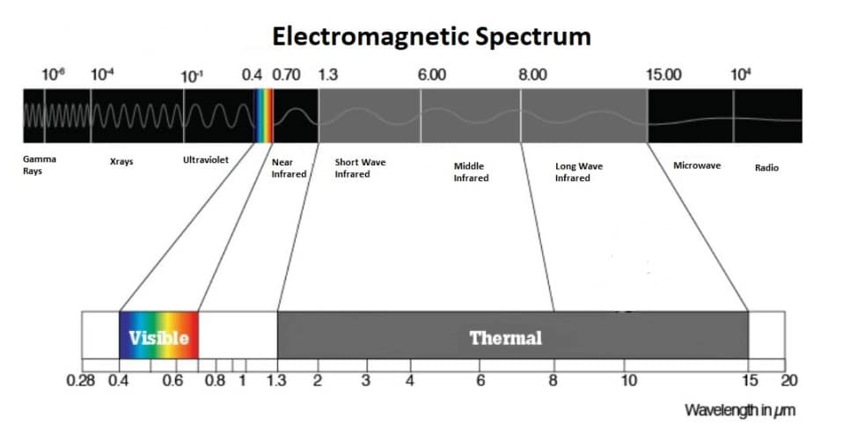
Problem Statement
Most existing human pose datasets rely on Visible or grayscale images within the visible spectrum (0.4–0.7 µm).
The visible domain is limited by low-light conditions and privacy risks in sensitive environments.
Thermal cameras, operating in longer wavelengths (up to 15 µm), remain unaffected by illumination changes.
They also enhance privacy by recording only heat signatures instead of identifiable visual details.

Slide 6
Literature Review:
S. No. | Title | Author | Year of Publish | Journal/Conference | Technology Used | Dataset Used
1. | Human Pose Estimation Using Thermal Images[1]. | Javier Smith Patricio Loncomilla Javier Ruiz-del-Solar | 2023 | IEEE | CNNs: Used for pose estimation. Vision Transformers: Used for pose estimation. | Grayscale COCO UCH-Thermal-Pose (600 images)
2. | Multi-Person Pose Estimation Using Thermal Images [2]. | I-Chien Chen¹ Shiow-Jyu Tzou¹ Chang-Jen Wang² | 2020 | IEEE | 2D Pose Estimation: Neural network system. Lightweight IoT Models: For Internet-of-Things apps. | Color Images: With pose labels. Visible-Thermal Pairs: For labeling .
3. | Spatio-Temporal Information for Action Recognition in Thermal Video Using Deep Learning Model [3]. | P. Srihari J. Harikiran | 2022 | IJECES | Used deep spatio-temporal learning to extract spatial and temporal features from thermal video frames YOLO and CNN-Autoencoder models on IITR-IAR and TSF datasets. | IIITR-IAR: 21 thermal human actions. TSF: Thermal fall Images.
4. | OpenThermalPose: An Open-Source Annotated Thermal Human Pose Dataset and Initial YOLOv8-Pose Baselines [4]. | Askat Kuzdeuov Darya Taratynova Alim Tleuliyev | 2024 | IEEE | YOLOv8-pose (COCO pre-trained) for detecting humans and 17 keypoints. Manual refinement of bounding boxes and keypoints for accuracy. | 6,090 thermal images with 14,315 annotated human instances. Captured during 15 sports exercises in indoor and outdoor environments.

Slide 7
Thermal Human Pose Datasets:
Dataset | Keypoints | Bounding Box | Labeled Images | Labeled People | Single/Multi Person | Environment | Dataset Type
ThermalPose [1] | 19 | No | 2,000 | N/A | Single, Multi | Indoor | Person Detection
SLP [2] | 14 | No | 14,715 | 14,715 | Single | Indoor | Person Detection
UCH-Thermal-Pose [3] | 17 | Yes | 906 | 1,378 | Single, Multi | Indoor, Outdoor | Person Detection
OpenThermalPose [4] | 17 | Yes | 6,090 | 14,315 | Single, Multi | Indoor, Outdoor | Action classification
Thermal-IM (custom) | 17 | Yes | 3138 | 3138 | Single | Indoor | Action Classification
[1] Chen, I. C., Wang, C. J., Wen, C. K., & Tzou, S. J. (2020). Multi-person pose estimation using thermal images. IEEE Access, 8, 174964-174971.
[2] Liu, S., Huang, X., Fu, N., Li, C., Su, Z., & Ostadabbas, S. (2022). Simultaneously-collected multimodal lying pose dataset: Enabling in-bed human pose monitoring. IEEE Transactions on Pattern Analysis and Machine Intelligence, 45(1), 1106-1118.
[3] Smith, J., Loncomilla, P., & Ruiz-Del-Solar, J. (2023). Human pose estimation using thermal images. IEEE Access, 11, 35352-35370.
[4] A. Kuzdeuov, D. Taratynova, A. Tleuliyev and H. A. Varol, "OpenThermalPose: An Open-Source Annotated Thermal Human Pose Dataset and Initial YOLOv8-Pose Baselines," 2024 IEEE 18th International Conference on Automatic Face and Gesture Recognition (FG), Istanbul, Turkiye, 2024, pp. 1-8, doi: 10.1109/FG59268.2024.10581992

Slide 8
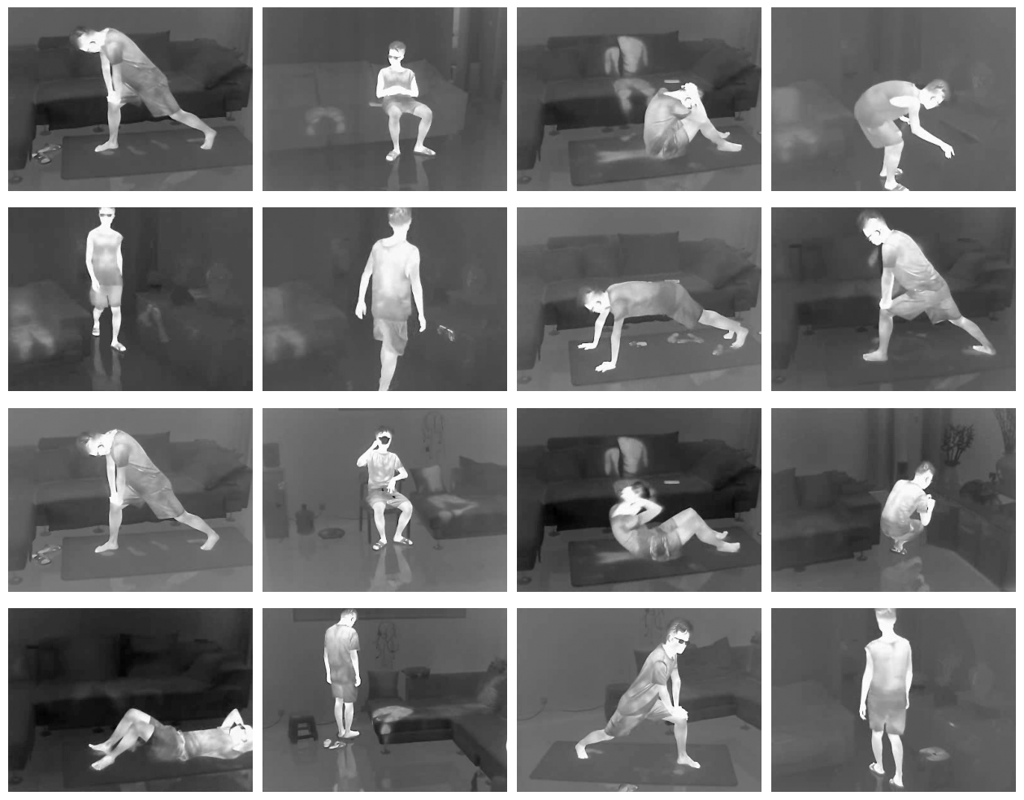
🔍 Thermal Indoor Motion (Thermal-IM) Dataset
The Thermal Indoor Motion (Thermal-IM) dataset was developed to fill the gap in visible-thermal datasets for indoor environments and human-object interactions.
Captured with a Hikvision DS-2TD4237T-10 camera at 15 fps, 288×384 resolution.
Dataset includes 783 video clips with 560,000+ frames.
Provides about 10.4 hours of indoor human activity footage.
Collected across different rooms and angles, forming the base for pose estimation and action recognition.
Includes indoor scenes and subtle actions for pose and action recognition research.
Fig 4 : Sample images from the Thermal-IM dataset.

Slide 9
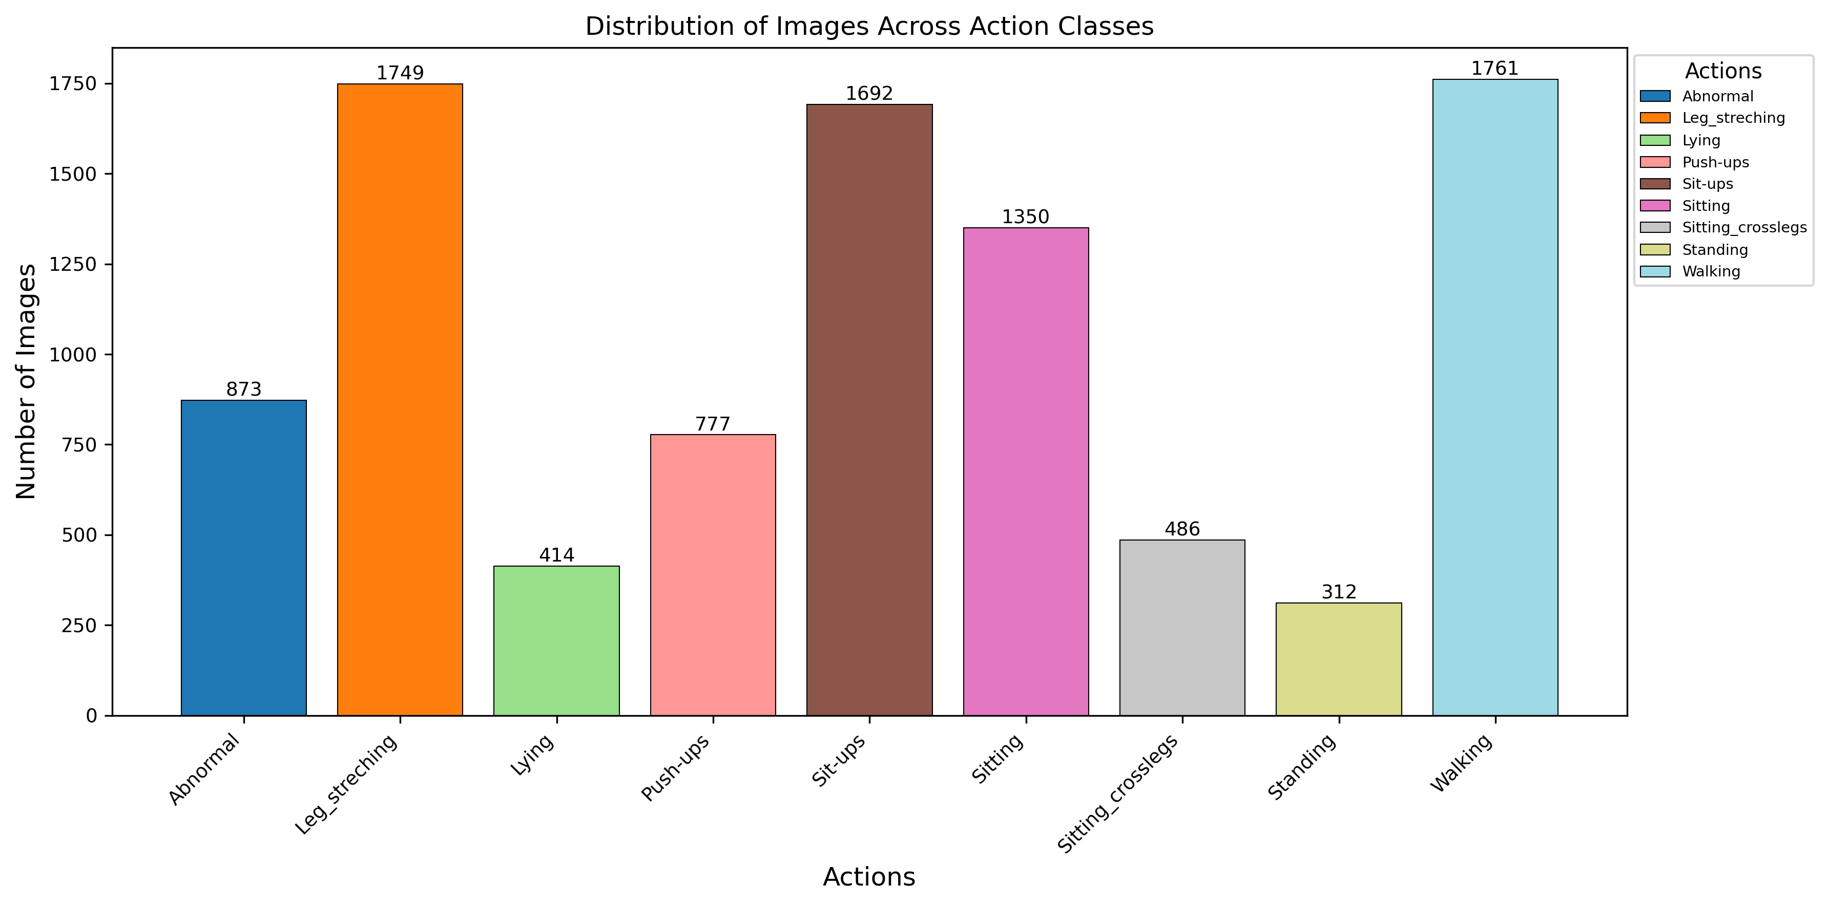
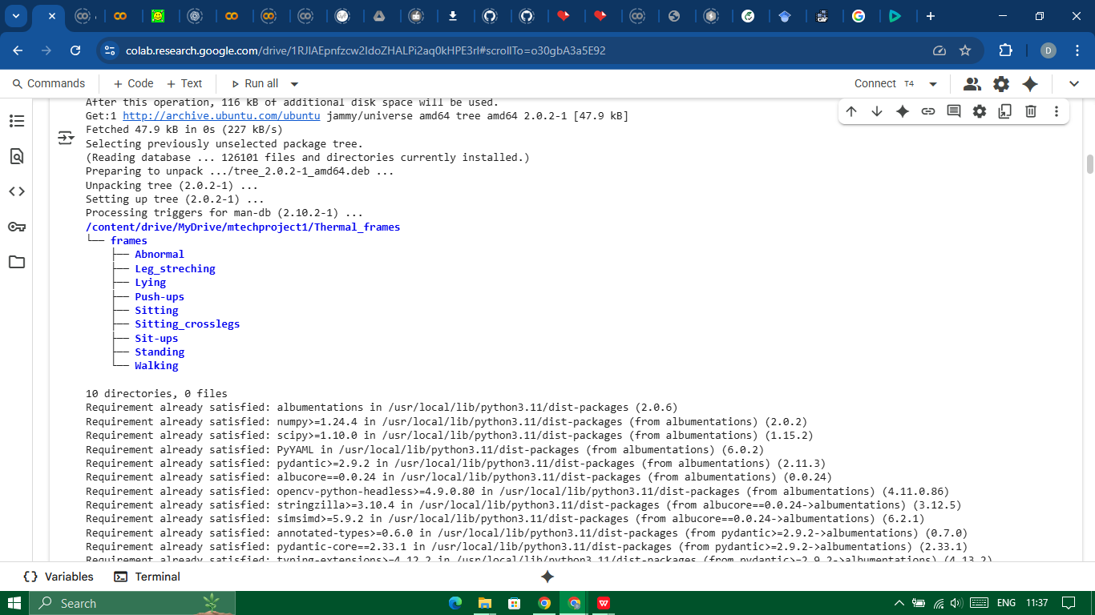
Step 1: Data Extraction
Processed 53 thermal videos (15 FPS) with JSON annotations.
Focused on 9 action classes.
Extracted frames/clips and organized into class folders.
Resized frames from 288×384 to 640×640 for YOLOv8-Pose.
Fig. 5 Bar chart : Image Distribution

Slide 10
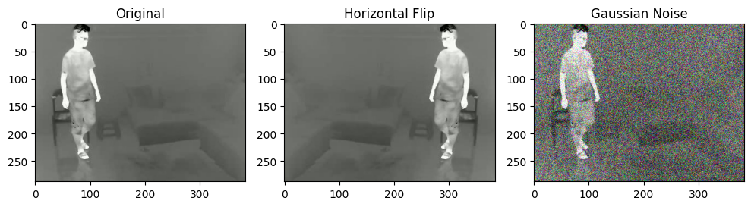
Step 2: Data Preprocessing
Resized all thermal frames to 640×640 using Pillow library for uniform input dimensions.
Applied horizontal flip and Gaussian noise augmentations with PyTorch/torchvision.
These augmentations improved robustness and reduced overfitting for real-world variation.
Final dataset: 9,414 labeled thermal images across class folders, covering both static and dynamic actions like sitting, walking, and push-ups.
Fig 6: Data augmentation (a) Original, (b) Horizontally flipped,
(c) Gaussian noise.
Table 3 : Summary of Image Distribution Across Action Classes.
Class | Number of Images
Abnormal | 873
Leg_streching | 1,749
Lying | 414
Push-ups | 777
Sit-ups | 1,692
Sitting | 1,350
Sitting_crosslegs | 468
Standing | 312
Walking | 1,761
Total | 9,414

Slide 11
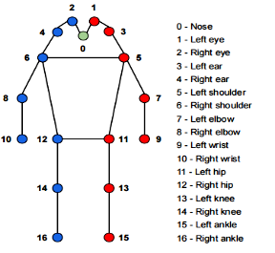
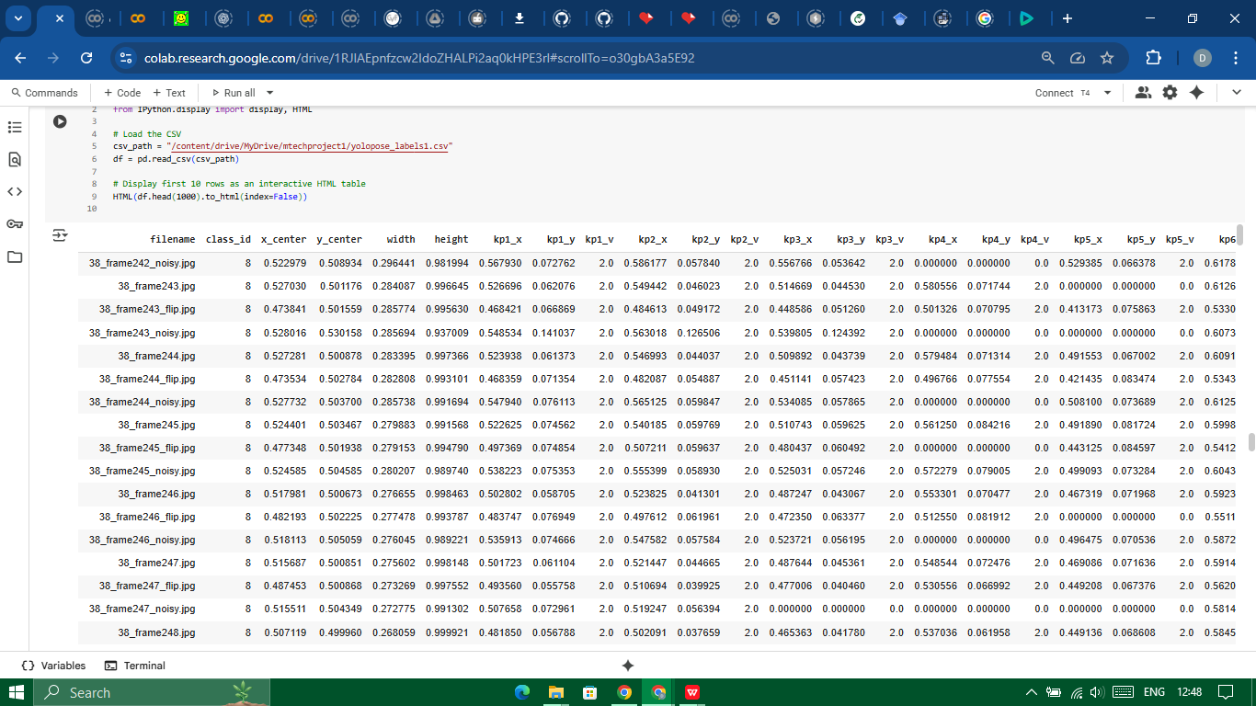
Step 3: Keypoint and Bounding Box Annotation
Annotated 9,414 thermal images with bounding boxes and 17 COCO keypoints.
Used YOLOv8m-pose (COCO-pretrained) for initial annotations, then manually corrected them.
Applied a 0.7 confidence threshold to remove weak detections.
Saved clean, verified data in YOLO format: 📁 images/ and 📁 labels/.
The dataset was then split into two folders:
📁 images/ — thermal input frames
📁 labels/ — corresponding annotation files
Fig. 7 Keypoints annotation format used for Thermal-IM dataset
Fig. 8 Annotations saved in COCO Format in .txt file

Slide 12
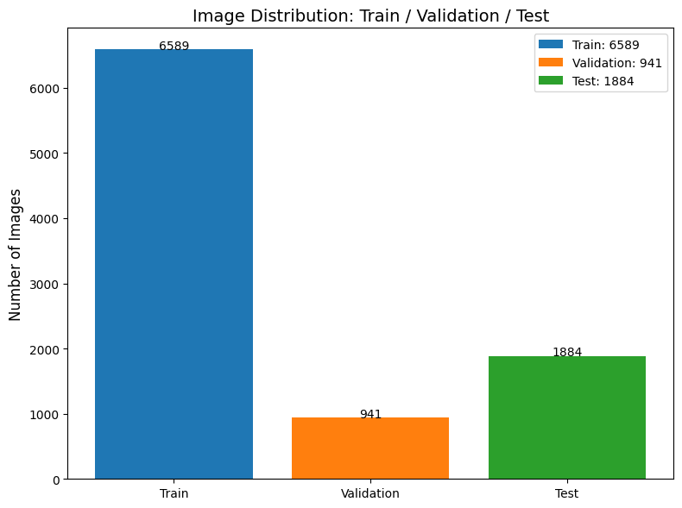
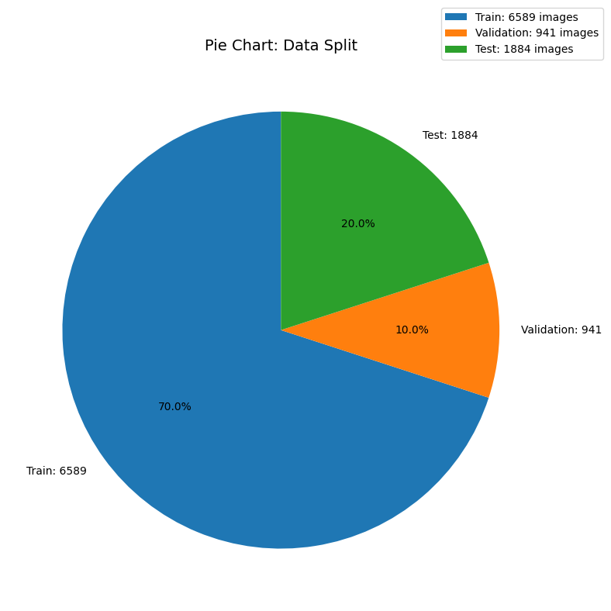
Step 4: Training and Validation on the Thermal-IM Dataset
The dataset was split into three parts to ensure fair evaluation across different YOLOv8-pose variants:
70% for training → 6,589 images
10% for validation → 941 images
20% for testing → 1,884 images
Fig. 10 Image Distribution
During training:
The model learned to detect humans and predict 17 keypoints from thermal images.
The validation set was used to monitor the training process, tune hyperparameters, and check if the model was overfitting.
Fig. 9 Pie chart: Data split

Slide 13
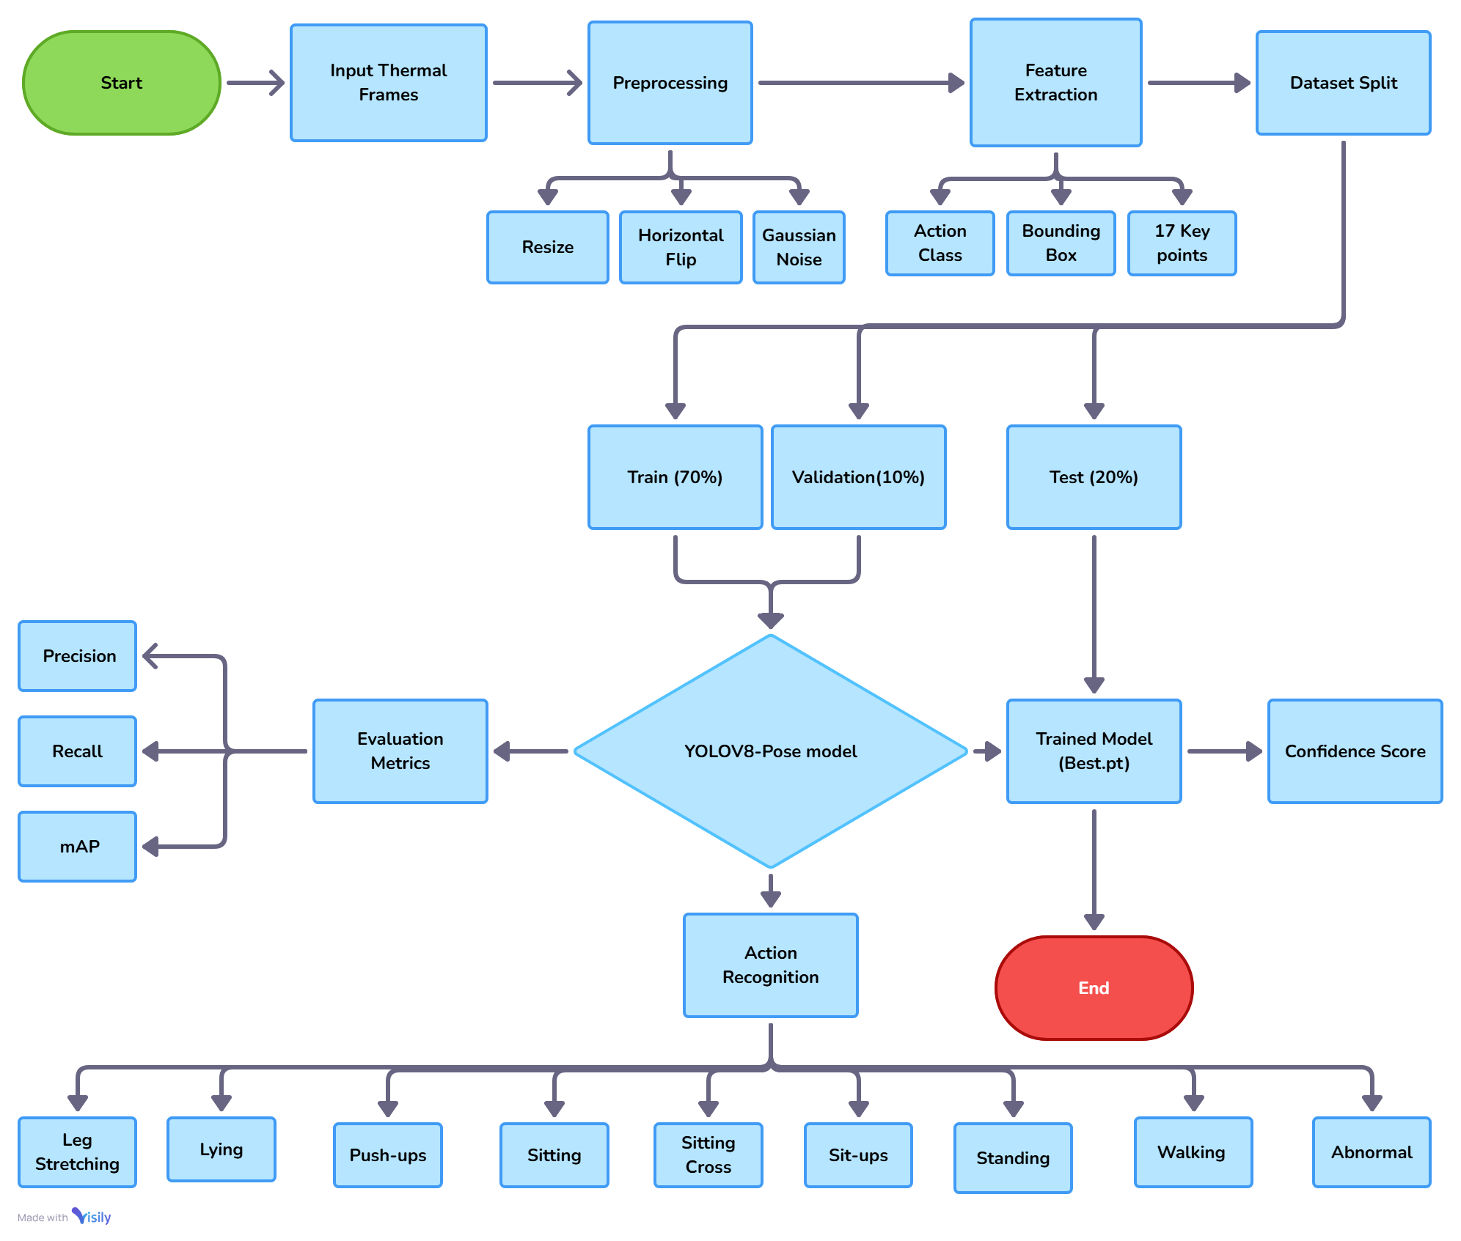
Flowchart: Training and Testing Human Pose Estimation on Thermal Images

Slide 14
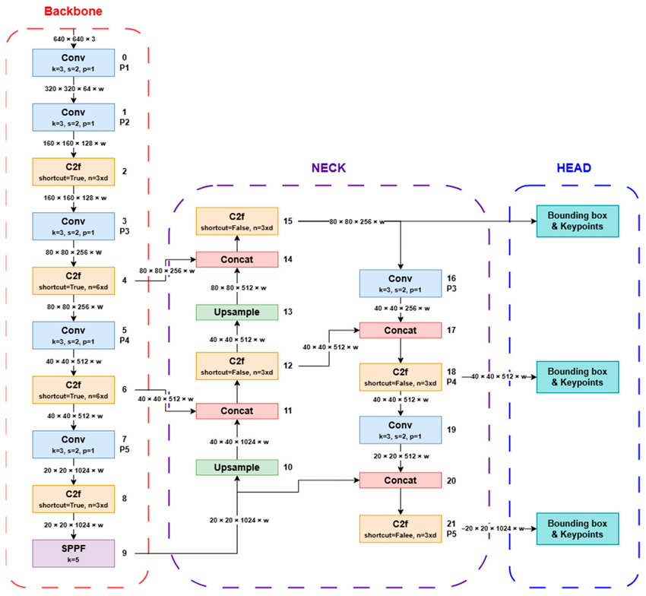
Methodology: Architecture of YOLOV8
Version Parameters: Determined by depth_multiple, width_multiple, and max_channels.
Stem: Two convolution blocks (stride 2, kernel 3) reduce input resolution and extract initial features.
Backbone: Extracts features from the input image and reduces resolution; uses shortcuts to retain important information.
Neck: Combines and upsamples feature maps, capturing multi-scale information for better detection and pose estimation.
Head: Detects humans at small, medium, and large scales and predicts keypoints; cleans results using Non-Maximum Suppression.
Purpose: Optimized for real-time human detection and pose estimation in thermal imagery, ideal for monitoring, surveillance, and anomaly detection.

Slide 15
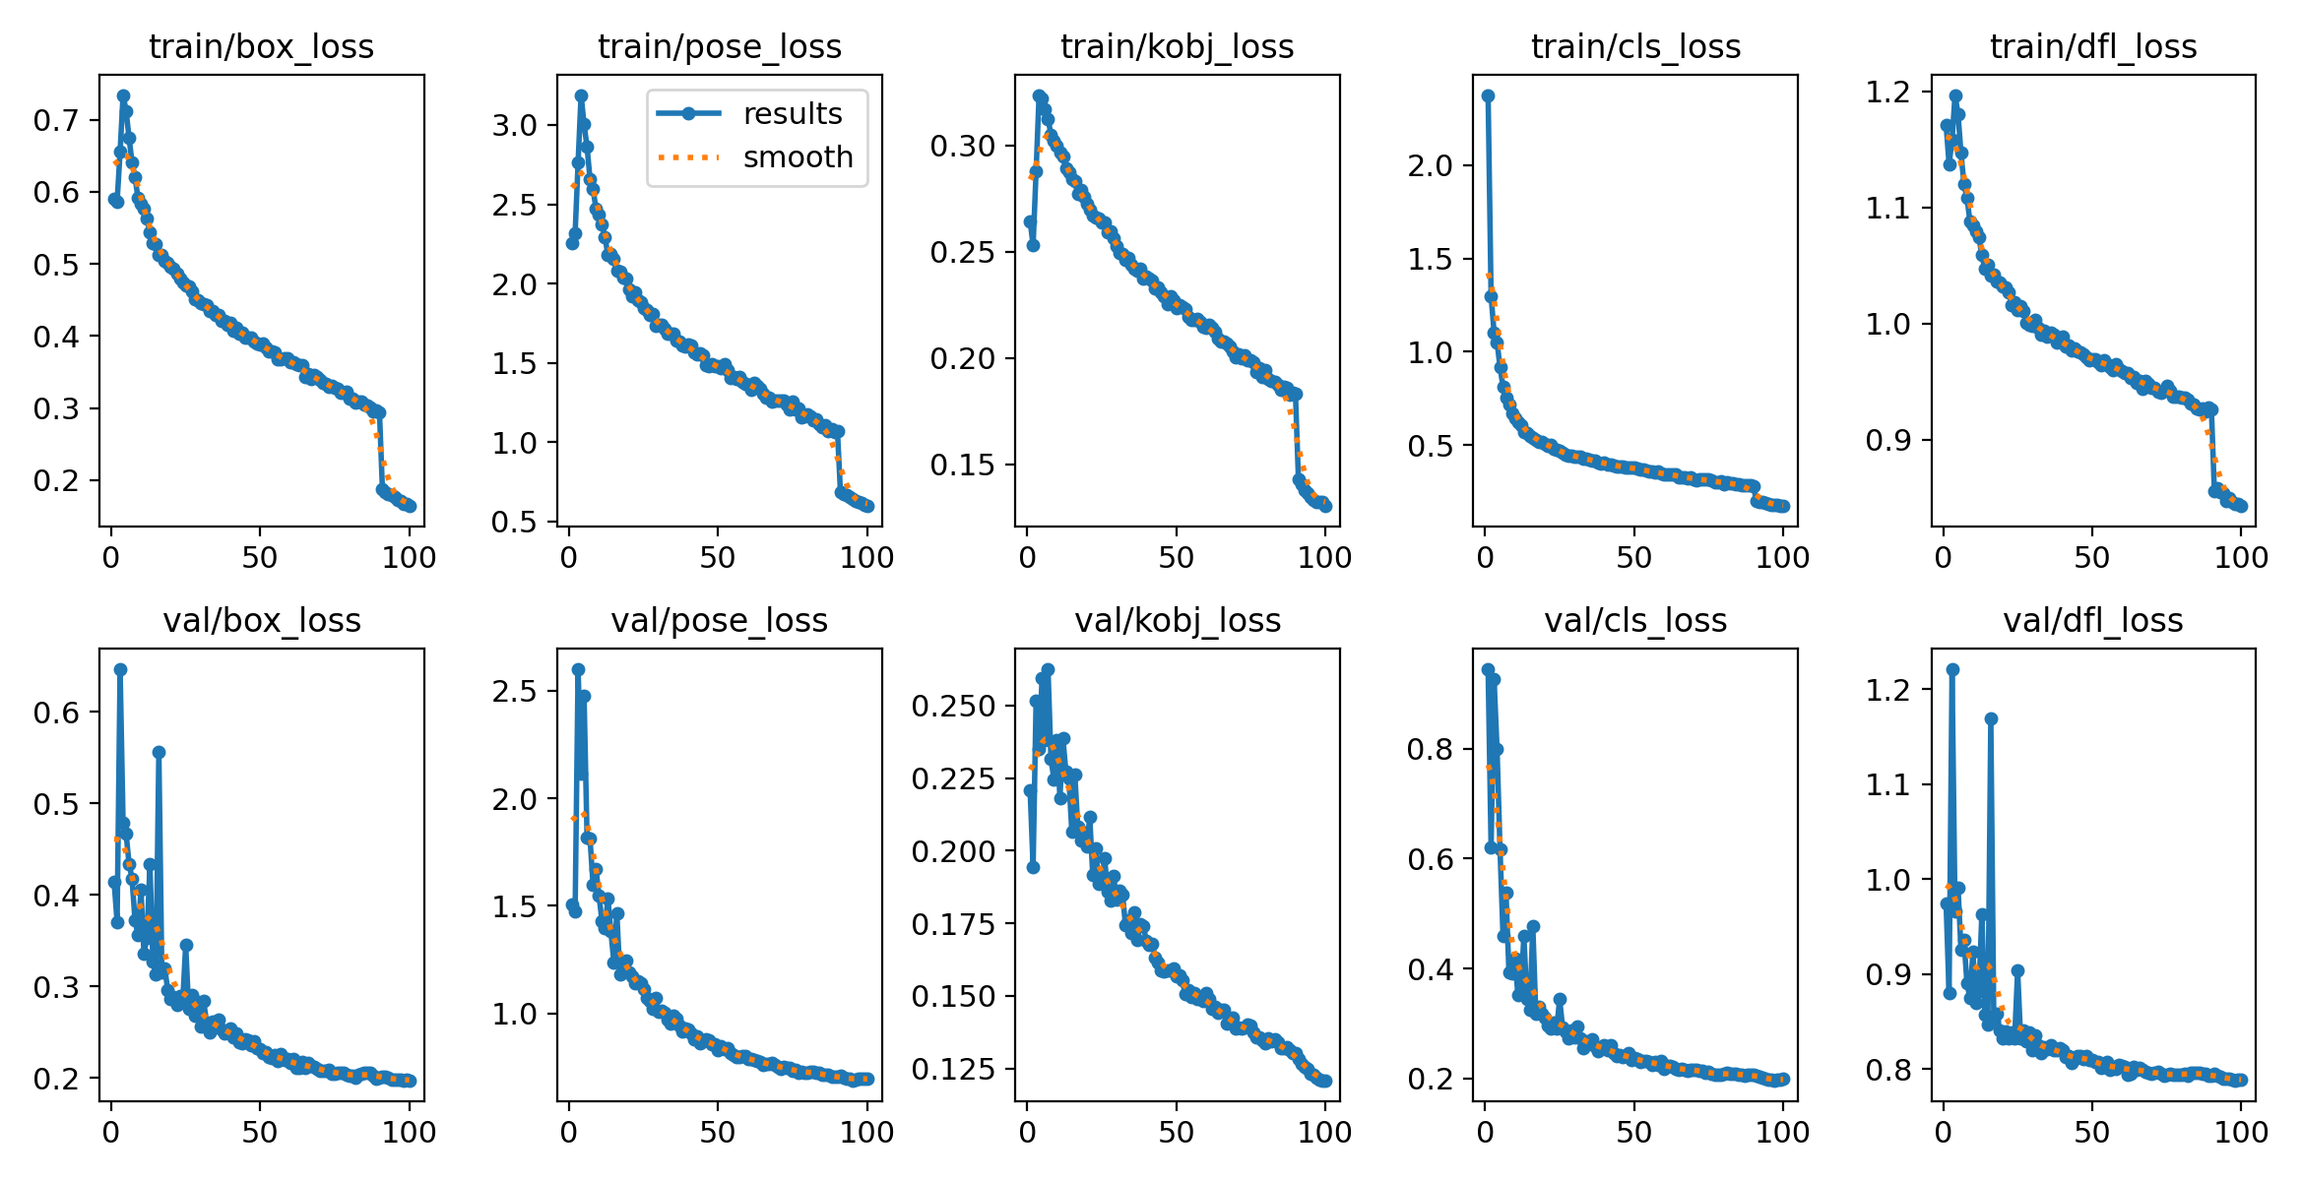
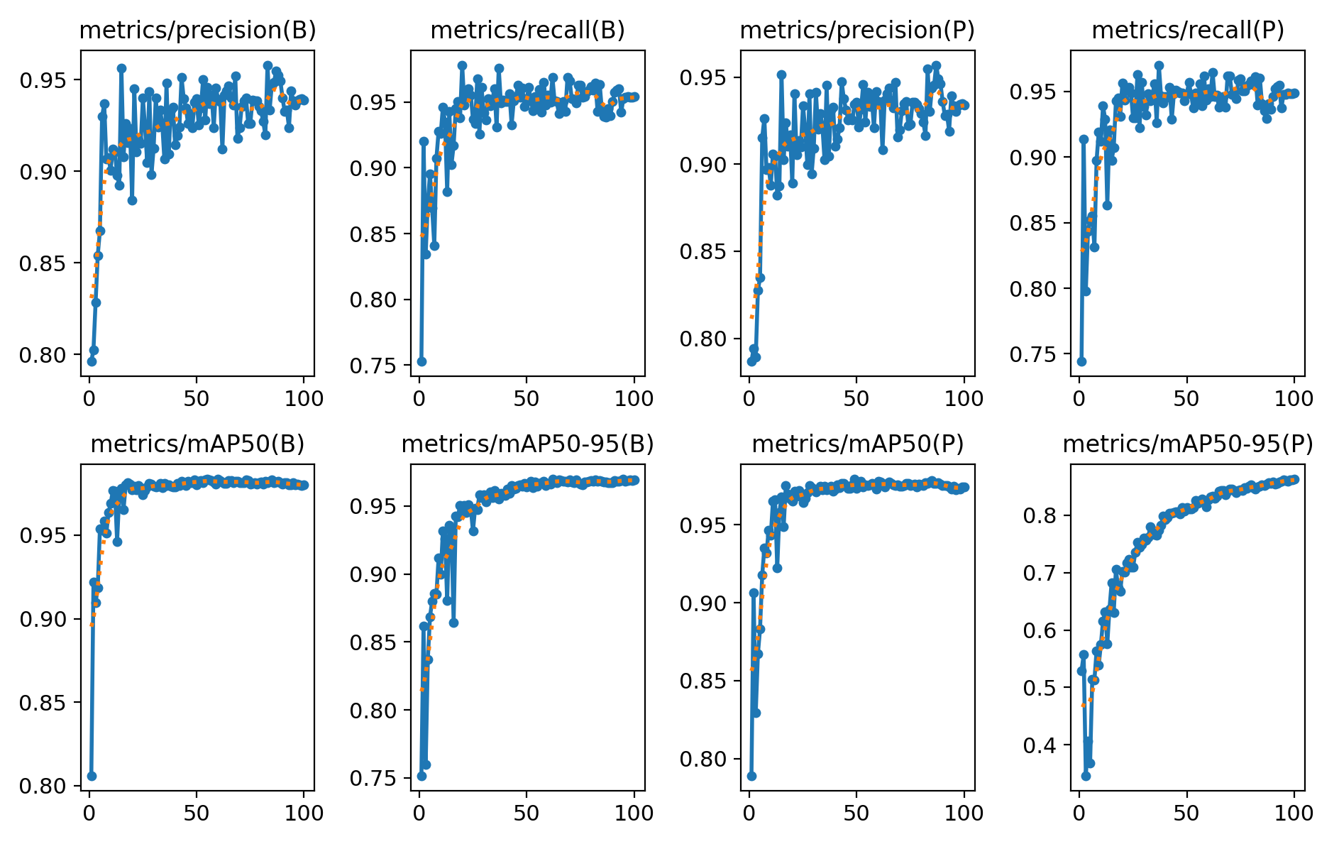
Model Training and Validation:
Training Overview & Loss Behavior
Model trained for 100 epochs with monitoring on training and validation sets.
Total loss = box_loss + pose_loss + cls_loss + auxiliary terms (dfl_loss, kobj_loss).
Loss components decreased over epochs, indicating accurate learning of bounding boxes, keypoints, and action classes.
Performance Metrics
Precision, recall, and mAP tracked on training and validation sets.
Metrics rose rapidly in early epochs and plateaued at high levels, showing successful training and generalization.

Slide 16
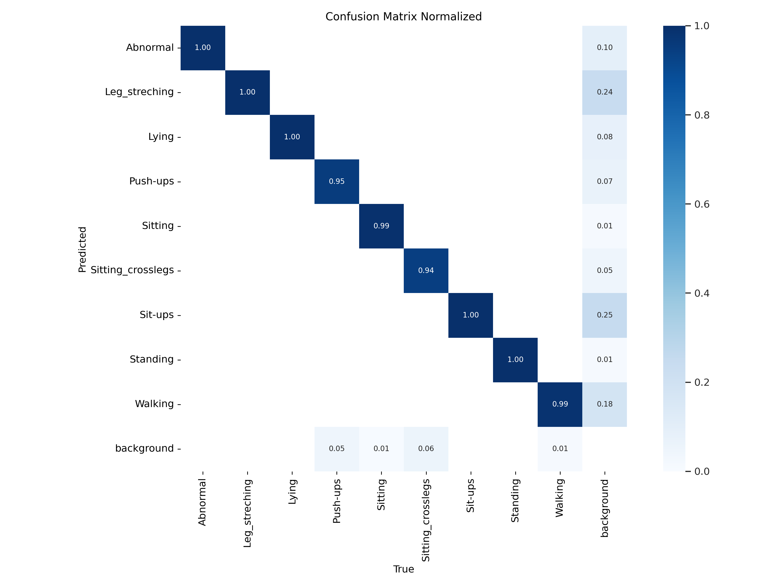
Confusion Matrix Analysis:
Confusion matrix shows correct and incorrect predictions.
True labels on x-axis, predicted labels on y-axis.
Dark diagonal cells indicate correct predictions.
Lighter off-diagonal cells show misclassifications.

Slide 17
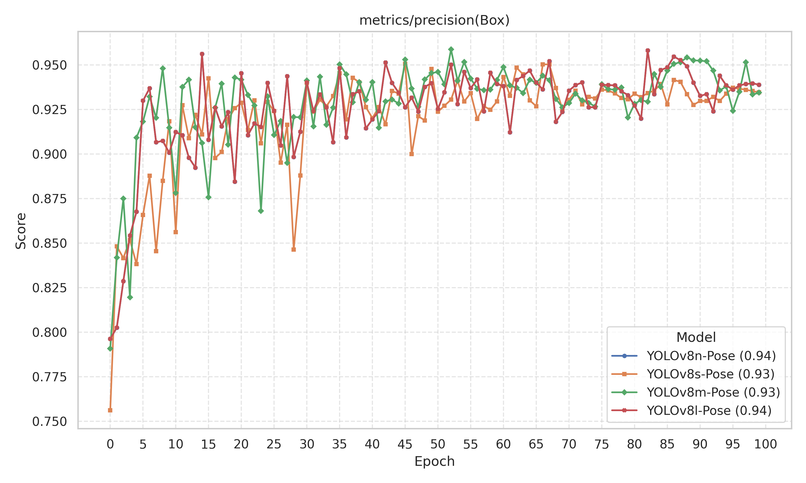
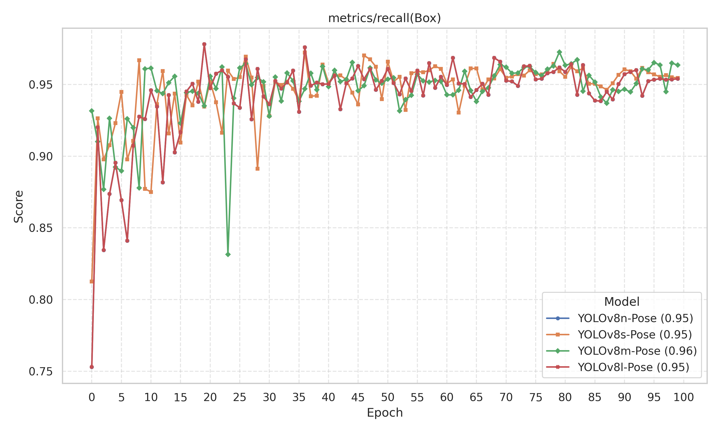
Result: Bounding Box Detection Metrics
Fig: Bounding Box Detection Precision vs. Epochs.
Fig: Bounding Box Detection Recall vs. Epochs.

Slide 18
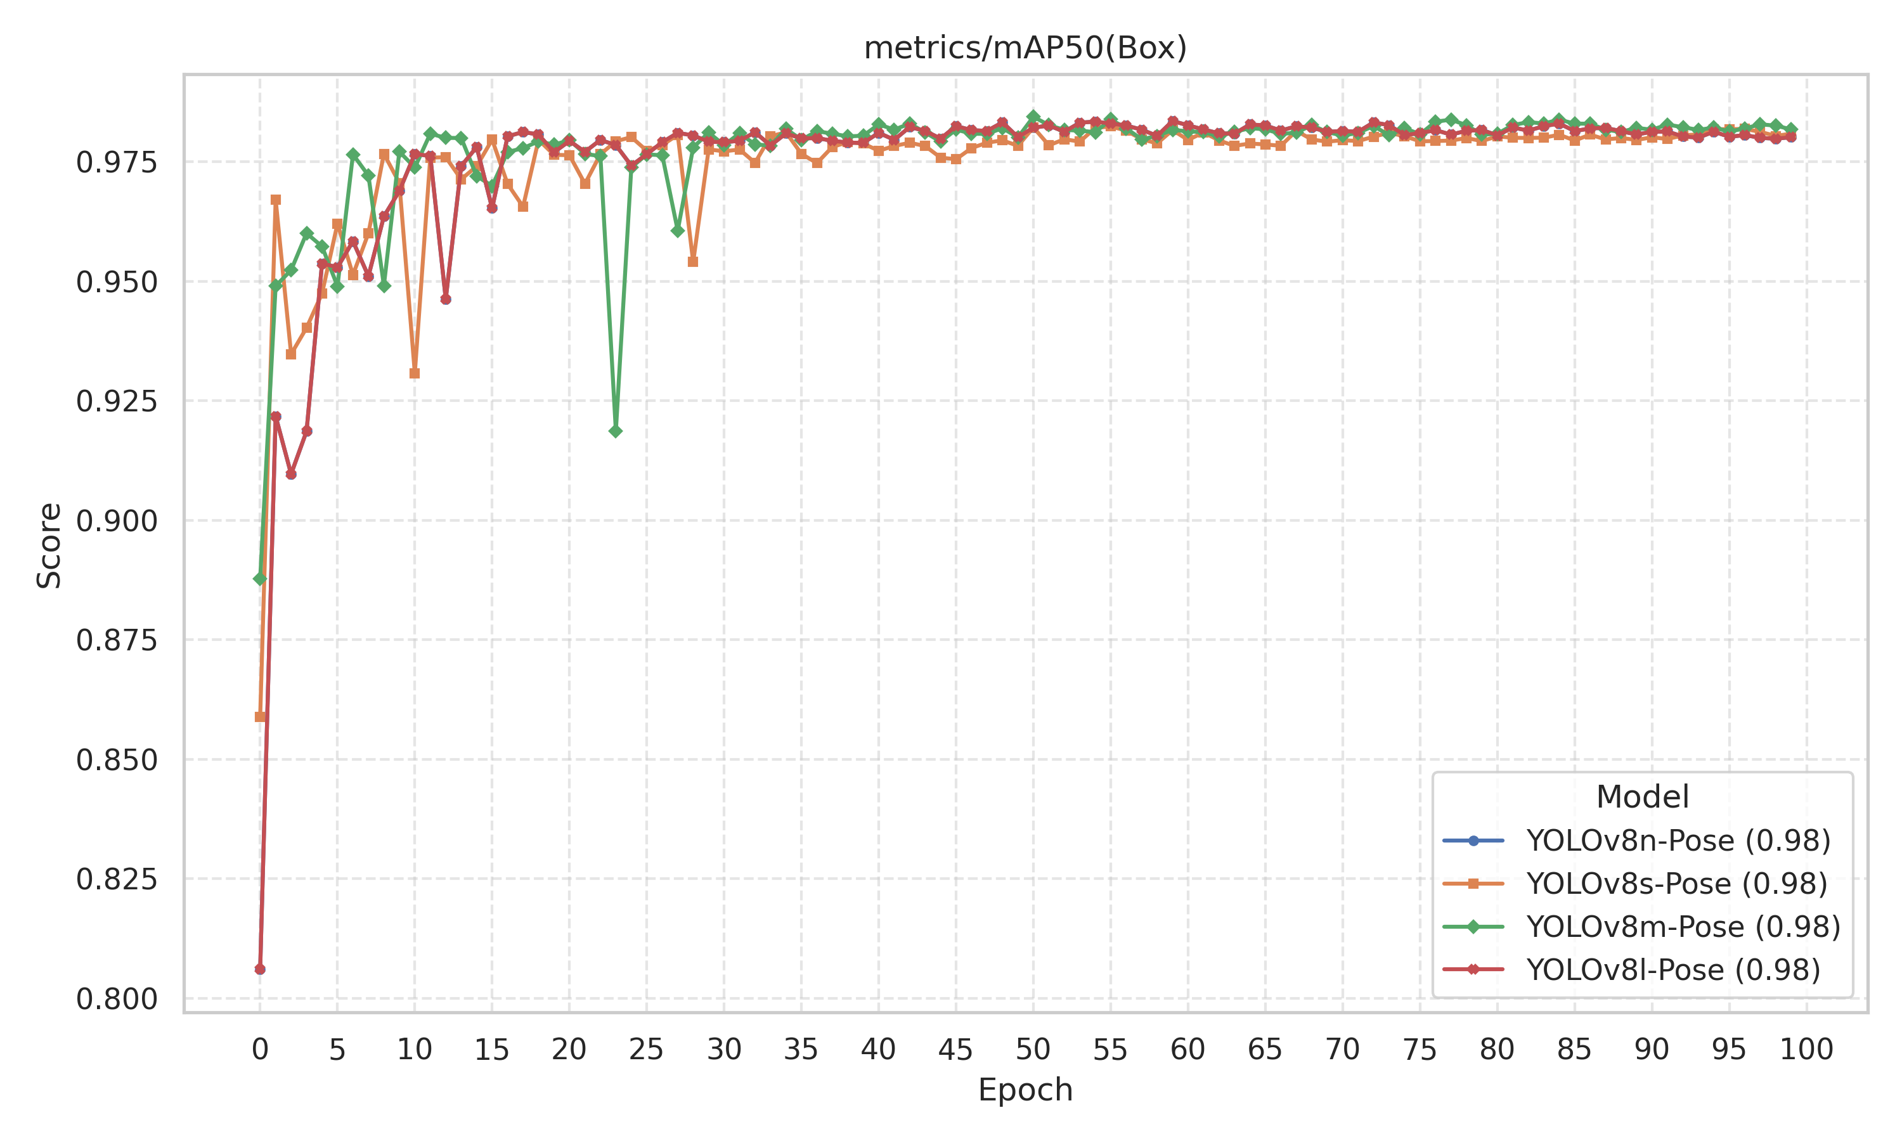
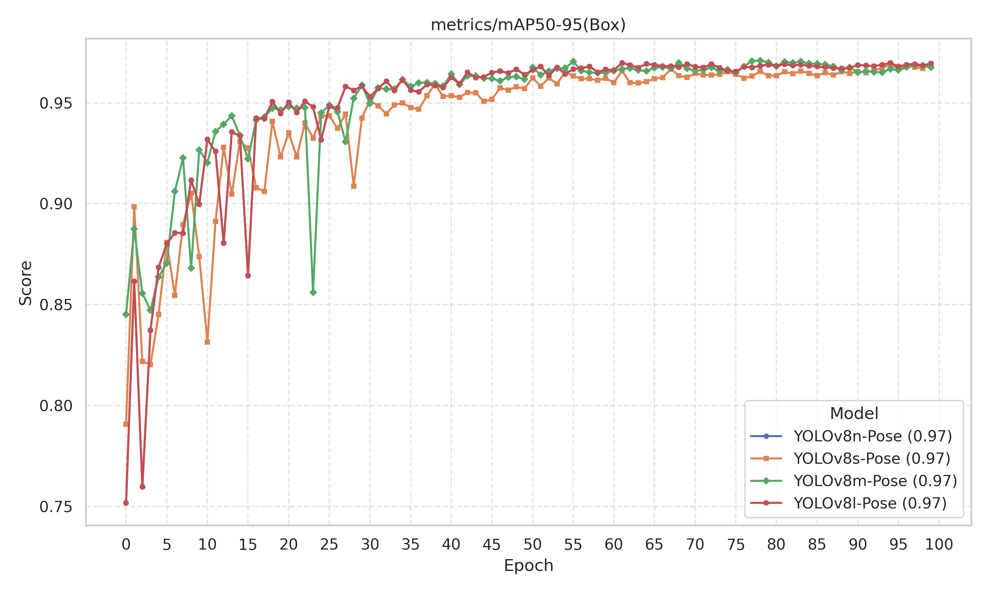
Fig: Bounding Box Detection mAP (IoU 0.50) vs. Epochs.
Fig: Bounding Box Detection mAP (IoU 0.50-0.95) vs. Epochs.

Slide 19
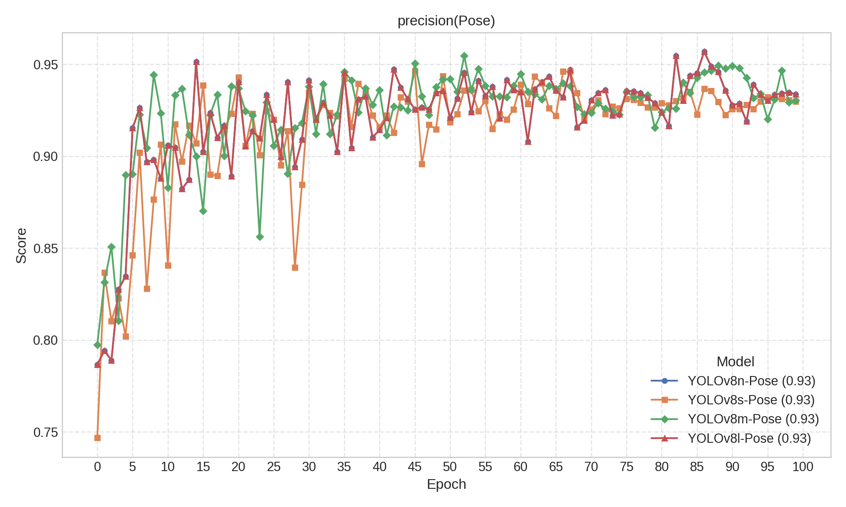
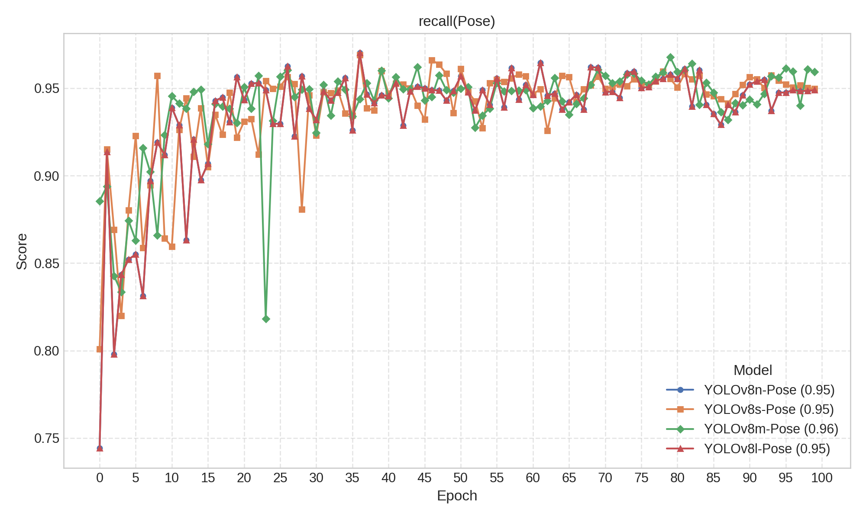
Pose Estimation Metrics
Fig : Pose Estimation Precision vs. Epochs.
Fig : Pose Estimation Recall vs. Epochs.

Slide 20
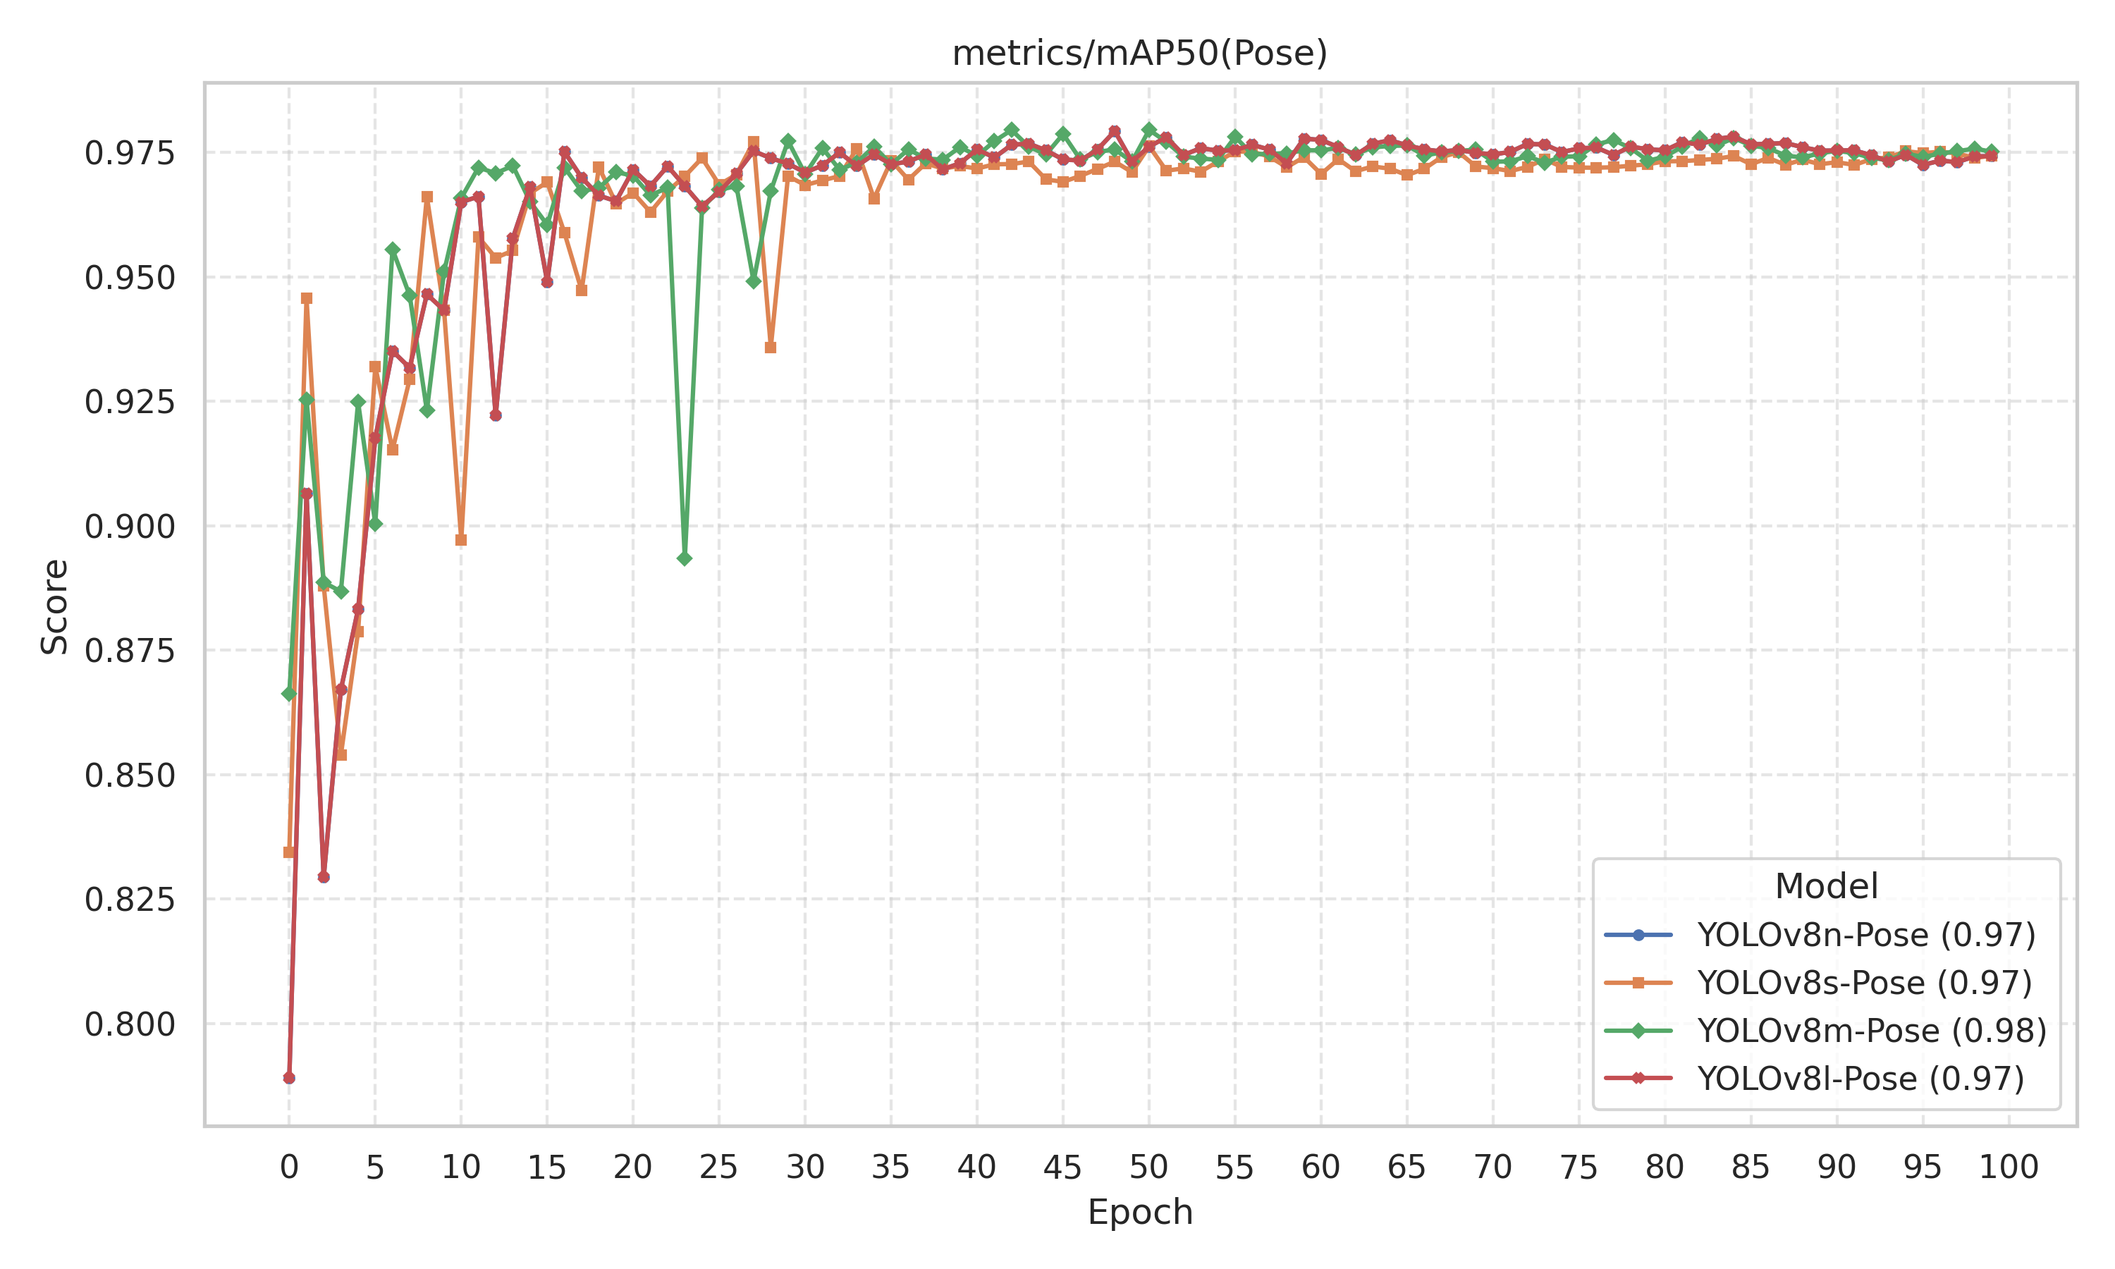
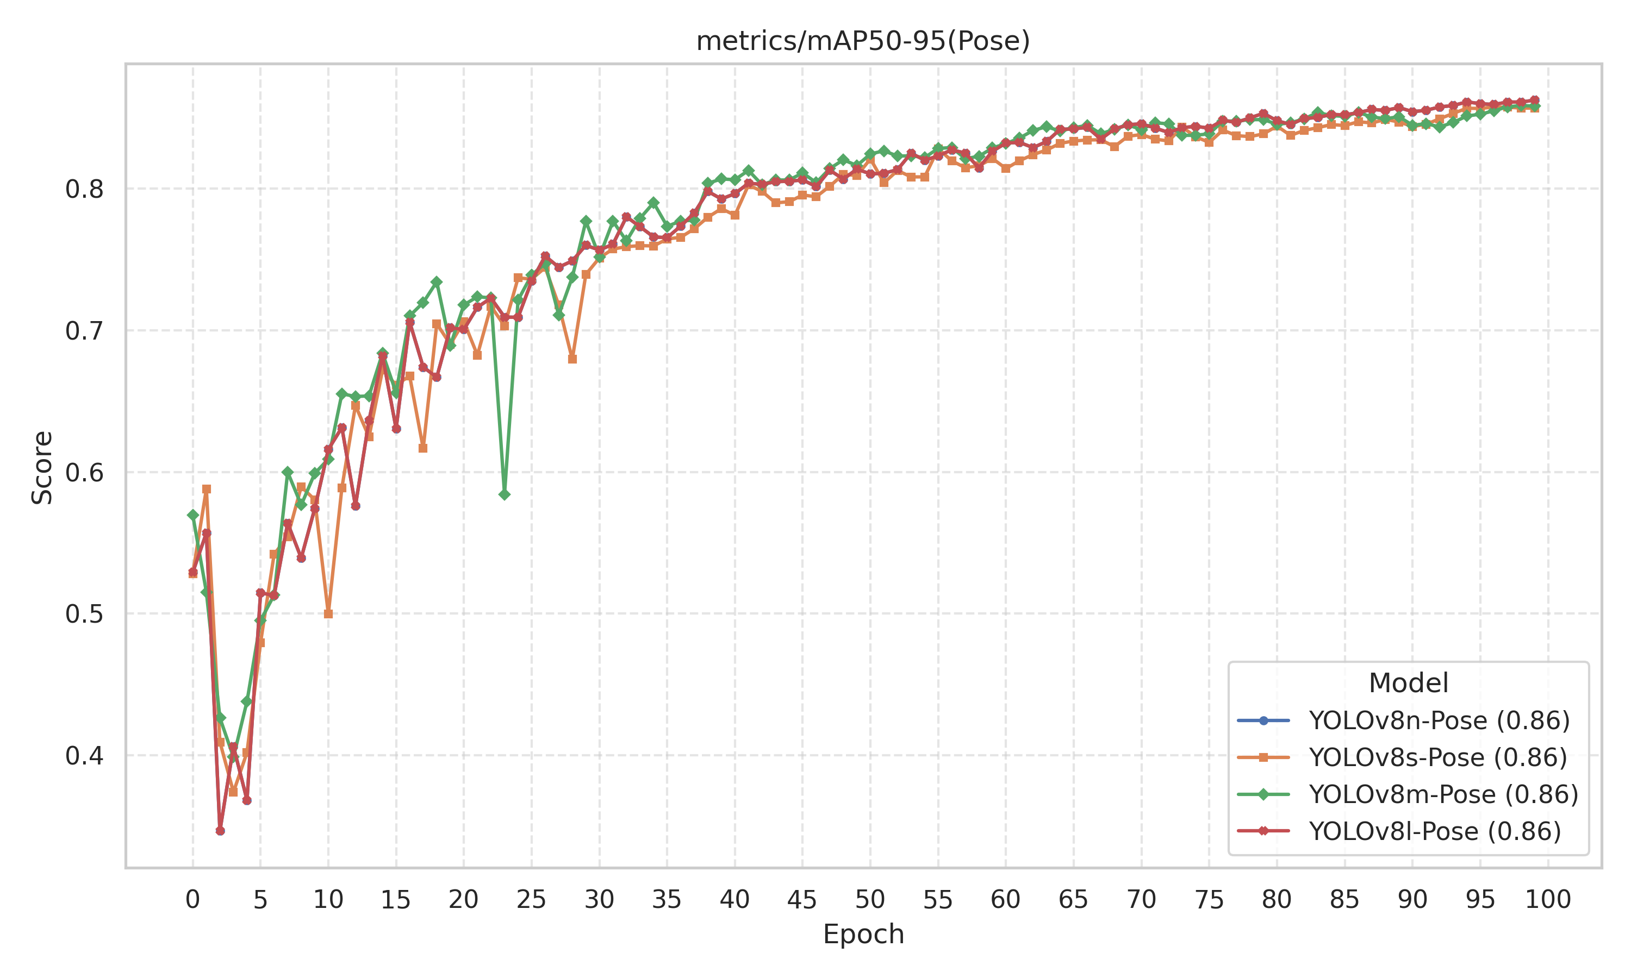
Fig : Pose Estimation mAP (IoU 0.50) vs. Epochs.
Fig : Pose Estimation mAP (IoU 0.50-0.95) vs. Epochs.

Slide 21
Table 1: Validation performance metrics of the YOLOv8n-pose model on the Thermal-IM Dataset.
CLASS | BOX |  |  |  | POSE
 | Precision | Recall | mAP@0.5 | mAP@0.5-0.95 | Precision | Recall | mAP@0.5 | mAP@0.5-0.95
All | 0.936 | 0.960 | 0.982 | 0.966 | 0.931 | 0.955 | 0.975 | 0.852
Abnormal | 0.936 | 0.996 | 0.991 | 0.969 | 0.936 | 0.996 | 0.991 | 0.877
Leg streching | 0.938 | 0.959 | 0.989 | 0.983 | 0.938 | 0.959 | 0.989 | 0.922
Lying | 0.913 | 0.960 | 0.981 | 0.972 | 0.913 | 0.960 | 0.981 | 0.899
Push-ups | 0.903 | 0.909 | 0.943 | 0.897 | 0.903 | 0.909 | 0.940 | 0.734
Sitting | 0.993 | 0.994 | 0.995 | 0.985 | 0.978 | 0.979 | 0.988 | 0.914
Sitting crosslegs | 0.914 | 0.944 | 0.985 | 0.985 | 0.914 | 0.944 | 0.974 | 0.850
Sit-ups | 0.948 | 0.920 | 0.978 | 0.955 | 0.948 | 0.920 | 0.978 | 0.693
Standing | 0.924 | 1.000 | 0.992 | 0.976 | 0.924 | 1.000 | 0.992 | 0.957
Walking | 0.957 | 0.956 | 0.986 | 0.971 | 0.928 | 0.927 | 0.946 | 0.822

Slide 22
Table 2: Validation performance metrics of the YOLOv8s-pose model on the Thermal-IM Dataset.
CLASS | BOX |  |  |  | POSE
 | Precision | Recall | mAP@0.5 | mAP@0.5-0.95 | Precision | Recall | mAP@0.5 | mAP@0.5-0.95
All | 0.935 | 0.955 | 0.981 | 0.969 | 0.930 | 0.950 | 0.974 | 0.857
Abnormal | 0.936 | 0.986 | 0.992 | 0.978 | 0.936 | 0.986 | 0.992 | 0.895
Leg streching | 0.936 | 0.968 | 0.989 | 0.982 | 0.936 | 0.968 | 0.989 | 0.923
Lying | 0.908 | 0.960 | 0.980 | 0.972 | 0.908 | 0.960 | 0.980 | 0.878
Push-ups | 0.922 | 0.861 | 0.934 | 0.907 | 0.922 | 0.861 | 0.924 | 0.733
Sitting | 0.994 | 0.993 | 0.995 | 0.989 | 0.979 | 0.978 | 0.988 | 0.915
Sitting crosslegs | 0.915 | 0.944 | 0.984 | 0.984 | 0.915 | 0.944 | 0.976 | 0.879
Sit-ups | 0.936 | 0.915 | 0.973 | 0.951 | 0.936 | 0.915 | 0.973 | 0.699
Standing | 0.920 | 1.000 | 0.995 | 0.985 | 0.920 | 1.000 | 0.995 | 0.956
Walking | 0.945 | 0.964 | 0.987 | 0.975 | 0.916 | 0.935 | 0.952 | 0.834

Slide 23
Table 3: Validation performance metrics of the YOLOv8m-pose model on the Thermal-IM Dataset.
CLASS | BOX |  |  |  | POSE
 | Precision | Recall | mAP@0.5 | mAP@0.5-0.95 | Precision | Recall | mAP@0.5 | mAP@0.5-0.95
All | 0.934 | 0.965 | 0.983 | 0.969 | 0.929 | 0.961 | 0.976 | 0.859
Abnormal | 0.913 | 1.000 | 0.991 | 0.976 | 0.913 | 1.000 | 0.991 | 0.901
Leg streching | 0.933 | 0.968 | 0.988 | 0.981 | 0.933 | 0.968 | 0.988 | 0.929
Lying | 0.925 | 0.985 | 0.990 | 0.981 | 0.925 | 0.985 | 0.990 | 0.897
Push-ups | 0.919 | 0.902 | 0.941 | 0.907 | 0.919 | 0.902 | 0.930 | 0.720
Sitting | 0.996 | 0.993 | 0.995 | 0.987 | 0.989 | 0.985 | 0.991 | 0.923
Sitting crosslegs | 0.913 | 0.944 | 0.984 | 0.984 | 0.913 | 0.944 | 0.976 | 0.874
Sit-ups | 0.931 | 0.915 | 0.975 | 0.950 | 0.931 | 0.915 | 0.975 | 0.704
Standing | 0.920 | 1.000 | 0.995 | 0.983 | 0.920 | 1.000 | 0.995 | 0.955
Walking | 0.951 | 0.976 | 0.983 | 0.968 | 0.922 | 0.947 | 0.945 | 0.831

Slide 24
Table 4: Validation performance metrics of the YOLOv8l-pose model on the Thermal-IM Dataset.
CLASS | BOX |  |  |  | POSE
 | Precision | Recall | mAP@0.5 | mAP@0.5-0.95 | Precision | Recall | mAP@0.5 | mAP@0.5-0.95
All | 0.939 | 0.954 | 0.980 | 0.969 | 0.934 | 0.949 | 0.974 | 0.862
Abnormal | 0.935 | 0.983 | 0.991 | 0.976 | 0.935 | 0.983 | 0.991 | 0.887
Leg streching | 0.940 | 0.975 | 0.989 | 0.985 | 0.940 | 0.975 | 0.989 | 0.929
Lying | 0.920 | 0.960 | 0.981 | 0.973 | 0.920 | 0.960 | 0.981 | 0.915
Push-ups | 0.922 | 0.861 | 0.934 | 0.912 | 0.922 | 0.861 | 0.934 | 0.735
Sitting | 0.996 | 0.993 | 0.995 | 0.987 | 0.989 | 0.985 | 0.993 | 0.919
Sitting crosslegs | 0.912 | 0.944 | 0.982 | 0.982 | 0.911 | 0.944 | 0.975 | 0.869
Sit-ups | 0.952 | 0.907 | 0.970 | 0.946 | 0.942 | 0.898 | 0.967 | 0.698
Standing | 0.922 | 1.000 | 0.992 | 0.988 | 0.922 | 1.000 | 0.992 | 0.961
Walking | 0.950 | 0.964 | 0.986 | 0.974 | 0.921 | 0.935 | 0.946 | 0.845

Slide 25
Table 5: Comparison of Detection and Pose Estimation Performance Across Different YOLOv8-Pose Models on Thermal-IM Dataset
Model | BOX |  |  |  | POSE
 | Precision | Recall | mAP@0.5 | mAP@0.5-0.95 | Precision | Recall | mAP@0.5 | mAP@0.5-0.95
YOLOv8n-pose | 0.94 | 0.96 | 0.98 | 0.97 | 0.93 | 0.96 | 0.98 | 0.85
YOLOv8s-pose | 0.94 | 0.95 | 0.98 | 0.97 | 0.93 | 0.95 | 0.97 | 0.86
YOLOv8m-pose | 0.93 | 0.97 | 0.98 | 0.97 | 0.93 | 0.96 | 0.98 | 0.86
YOLOv8l-pose | 0.94 | 0.95 | 0.98 | 0.97 | 0.93 | 0.95 | 0.97 | 0.86
YOLOv8 models (n, s, m, l) evaluated on thermal images for detection and pose estimation.
Object detection: high precision and recall, mAP@0.5 ≈ 0.98, mAP@0.5:0.95 ≈ 0.97 across all models.
Pose estimation: keypoint precision 0.93–0.96, mAP@0.5 ≈ 0.98, mAP@0.5:0.95 ≈ 0.85–0.86.
Shows strong performance for thermal human detection with varying model sizes.

Slide 26
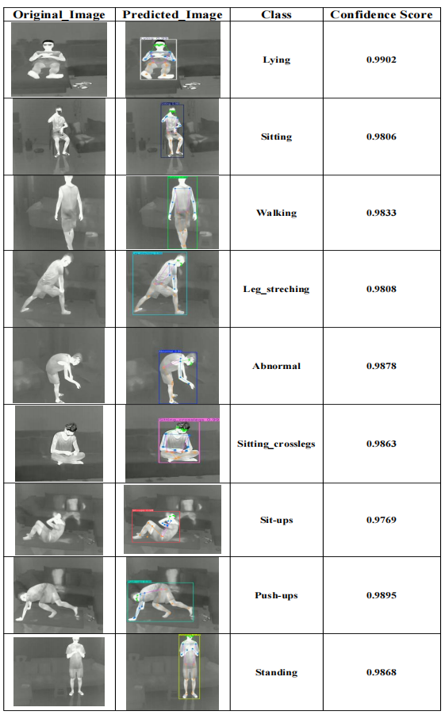
Qualitative Results – YOLOv8-Pose Performance
Figure displays thermal frames with original images, predicted poses, bounding boxes, class labels, and confidence scores (0.9769–0.9902).
The model accurately identifies challenging poses like Sit-ups, Push-ups, and Sitting crosslegs despite occlusions in thermal data.
Top confidence scores: Lying – 0.9902, Push-ups – 0.9895, Abnormal – 0.9878.
These results show the model’s strength in handling low-contrast thermal imagery, recognizing subtle human actions, and supporting reliable anomaly detection in surveillance contexts.

Slide 27
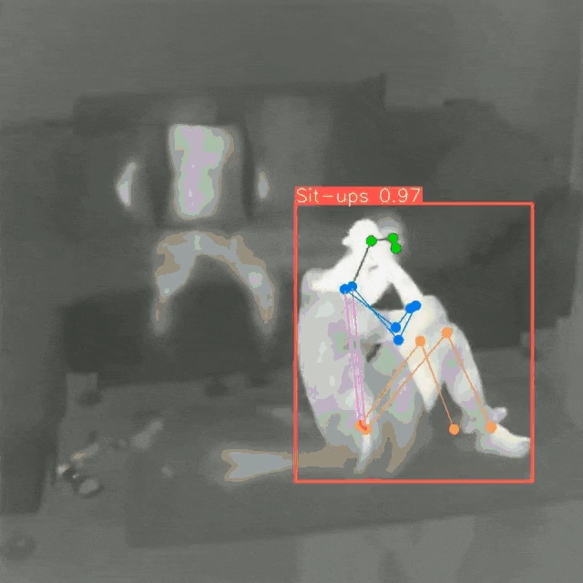
Action Recognition Video Demo:
Human Action Recognition in Thermal Video

Slide 28
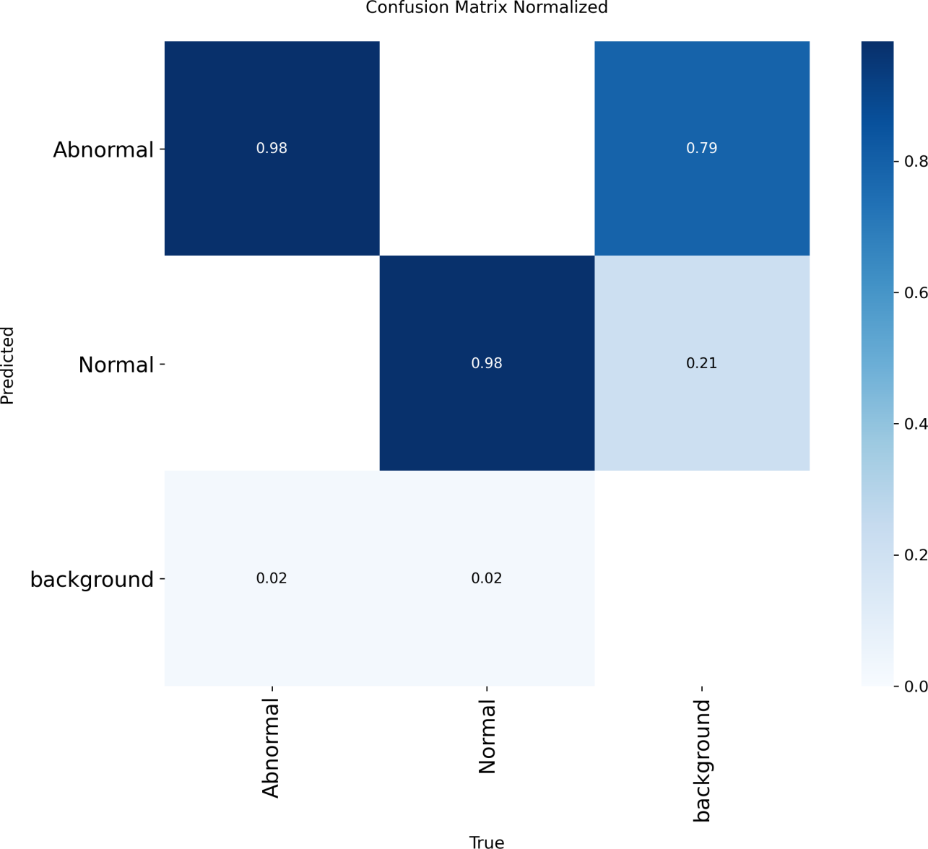
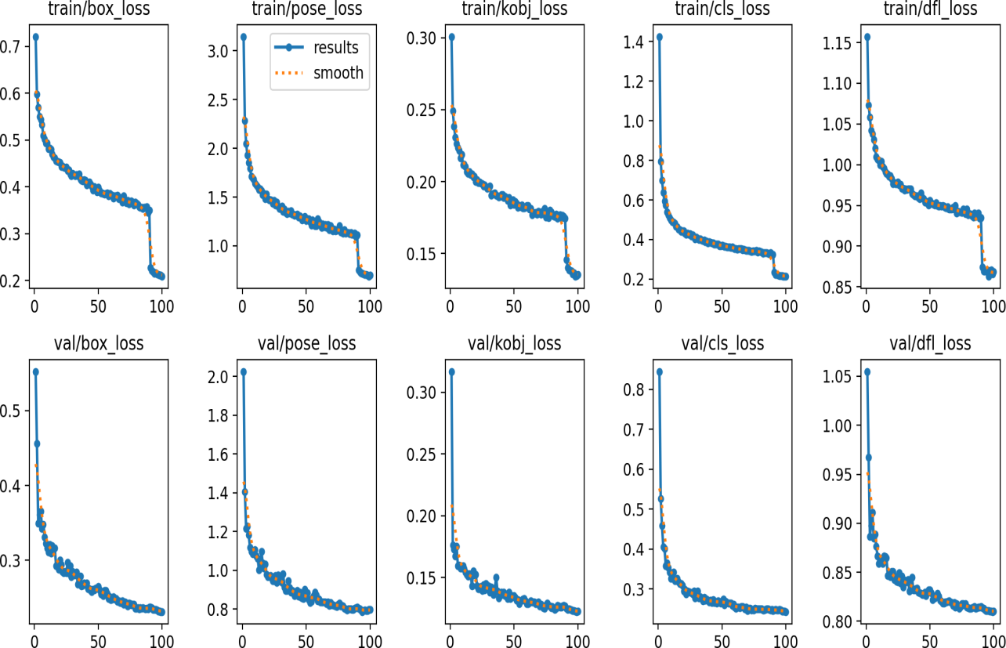
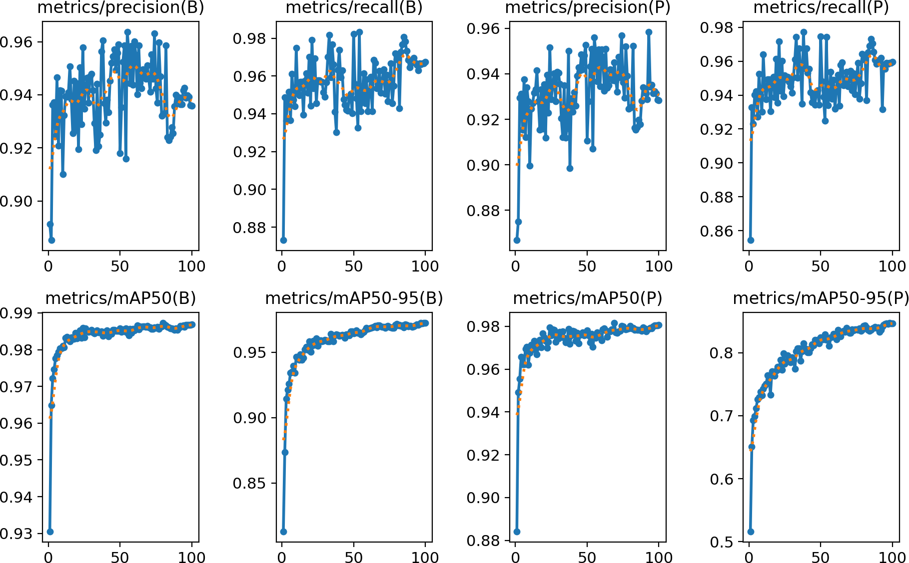
YOLOv8n-Pose Model Evaluation Results for Anomaly Detection
Fig. Training and validation loss curves .
The model achieved 98% accuracy in correctly identifying both Abnormal and Normal classes.
It struggled with the Background class, misclassifying 79% of its instances as Abnormal.
Fig: Model performance metrics

Slide 29
Evaluation results of YOLOv8n-Pose on the Thermal-IM validation set.
Model | BOX |  |  |  | POSE
 | Precision | Recall | mAP@0.5 | mAP@0.5-0.95 | Precision | Recall | mAP@0.5 | mAP@0.5-0.95
All | 0.939 | 0.967 | 0.987 | 0.972 | 0.932 | 0.959 | 0.980 | 0.848
Abnormal | 0.918 | 0.955 | 0.983 | 0.966 | 0.918 | 0.955 | 0.983 | 0.824
Normal | 0.961 | 0.978 | 0.991 | 0.978 | 0.946 | 0.963 | 0.978 | 0.871
The model achieved keypoint mAP of 0.980 at IoU@0.5 and 0.848 at IoU@0.5:0.95.
For bounding boxes, it reached 0.987 at IoU@0.5 and 0.972 at IoU@0.5:0.95.
Consistent per-class results across Abnormal and Normal categories show strong robustness in thermal imaging conditions.

Slide 30
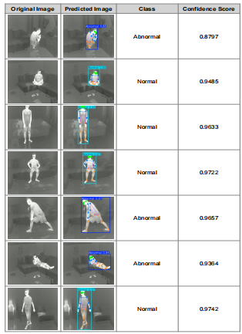
Pose Detection Results with Confidence Scores
Figure presents original and predicted thermal frames with corresponding pose keypoints, class labels, and confidence scores.
The model achieves high confidence levels, ranging from 0.8797 to 0.9742, across both Abnormal and Normal activities.
The integration of pose estimation notably improves the model’s accuracy and reliability in identifying anomalous human behavior.
These results demonstrate the model’s strong potential for real-world thermal surveillance and anomaly detection applications.

Slide 31
Conclusion
The YOLOv8-Pose models proved highly effective for thermal-based human action recognition and anomaly detection using the custom IM-Thermal dataset.
Among all variants, YOLOv8n-pose offered the best trade-off between accuracy and computational cost, making it ideal for real-time and resource-limited environments.
The model achieved excellent results with mAP@0.5 ≈ 0.98 and mAP@0.5:0.95 ≈ 0.96–0.97 for both bounding box and keypoint detection tasks.
For anomaly detection, the model accurately separated normal (0.99 mAP@0.5) and abnormal (0.98 mAP@0.5) actions, while maintaining strong pose estimation performance.
These outcomes demonstrate that thermal imaging combined with pose estimation offers a privacy-preserving, real-time solution for monitoring human Action across diverse environments.
Future plans include collecting more data and conducting extensive experiments with various Human Pose Estimation (HPE) models.

Slide 32
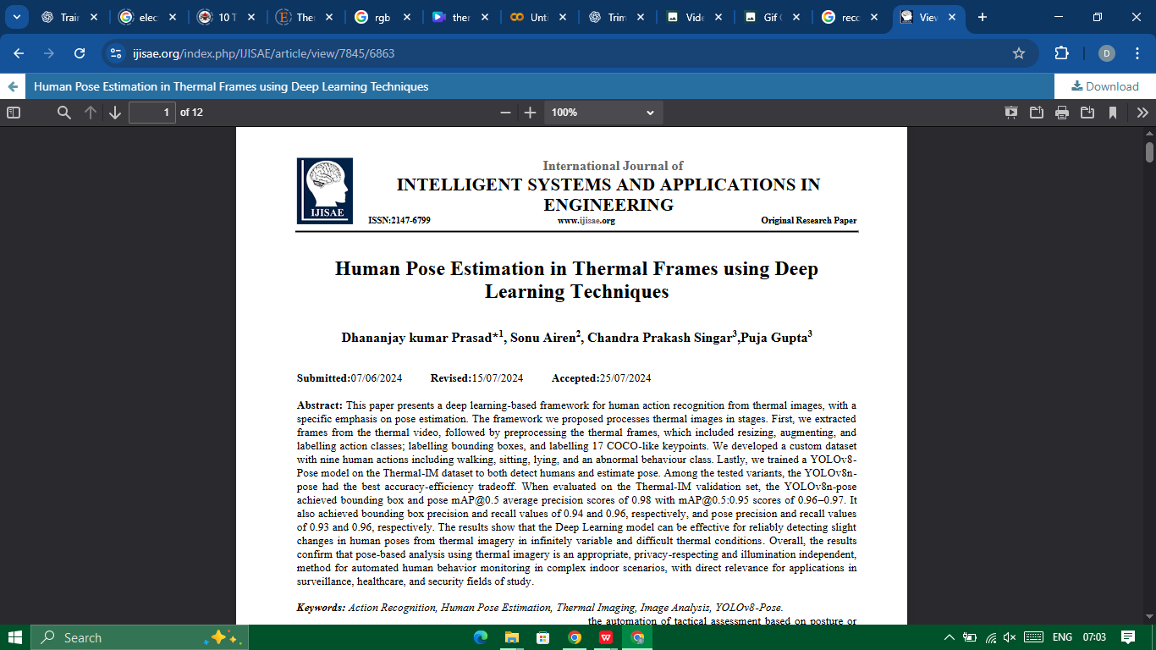
Published Papers
S. NO. | Paper Title | Paper Link
1. | Human Pose Estimation in Thermal Frames using Deep Learning Techniques | https://ijisae.org/index.php/IJISAE/article/view/7845
[1] Dhananjay kumar Prasad. (2024). Human Pose Estimation in Thermal Frames using Deep Learning Techniques. International Journal of Intelligent Systems and Applications in Engineering, 12(23s), 3713.

Slide 33
Reference:
[1] J. Smith, P. Loncomilla and J. Ruiz-Del-Solar, "Human Pose Estimation Using Thermal Images," in IEEE Access, vol. 11, pp. 35352-35370, 2023, doi: 10.1109/ACCESS.2023.3264714.
[2] I. -C. Chen, C. -J. Wang, C. -K. Wen and S. -J. Tzou, "Multi-Person Pose Estimation Using Thermal Images," in IEEE Access, vol. 8, pp. 174964-174971, 2020, doi: 10.1109/ACCESS.2020.3025413.
[3] Liu, S., Huang, X., Fu, N., Li, C., Su, Z., & Ostadabbas, S. (2022). Simultaneously-collected multimodal lying pose dataset: Enabling in-bed human pose monitoring. IEEE Transactions on Pattern Analysis and Machine Intelligence, 45(1), 1106-1118.
[4] A. Kuzdeuov, D. Taratynova, A. Tleuliyev and H. A. Varol, "OpenThermalPose: An Open-Source Annotated Thermal Human Pose Dataset and Initial YOLOv8-Pose Baselines," 2024 IEEE 18th International Conference on Automatic Face and Gesture Recognition (FG), Istanbul, Turkiye, 2024, pp. 1-8, doi: 10.1109/FG59268.2024.10581992.
[5] Z. Tang, W. Ye, W. Ma, and H. Zhao, “What happened 3 seconds ago? inferring the past with thermal imaging,” in Proceedings of the IEEE/CVF Conference on Computer Vision and Pattern Recognition (CVPR), 2023, pp. 17 111–17 120.
[6]Srihari P and D. J., Oct. 2022 “Spatio-Temporal Information for Action Recognition in Thermal Video Using Deep Learning Model”, IJECES, vol. 13, no. 8, pp. 669-680, .

Slide 34
THANK YOU

